Slide 1
Project Proposal
E-Plastic Management System
Presented By-
Aishorjo Biswas Sadia Anha Tanny Tarin Ahmed Shara
ID-UG02-47-18-045 ID-UG02-49-18-004 ID-UG02-50-19-020

Slide 2
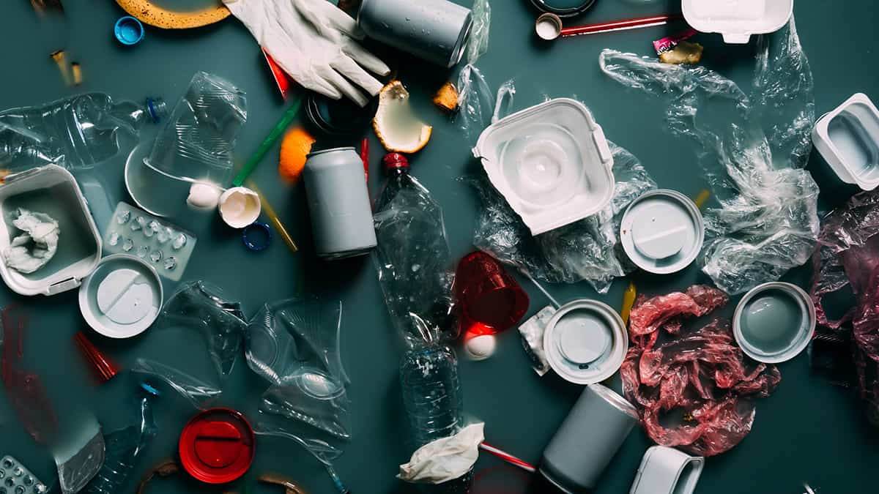
Project Outline
1. Introduction
2. Project Organization
3. Resource Requirements
4. System Model
5. User System Requirements
6. Query
7. Components Presents
8. Account Management
9. Challenges
10. Benefits
11. References

Slide 3
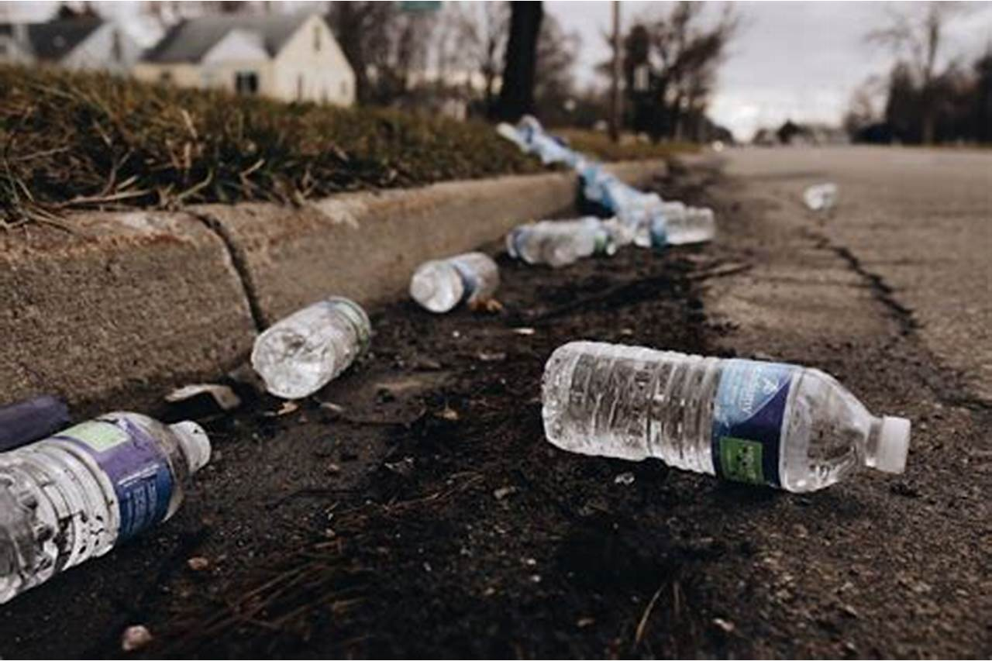
Introduction
E-Plastic management system is a website project, in the project we are used to
recycle the waste plastic. It is very helpful in order to overcome the wastage
issues of the plastics. The user can able to view the list of plastic categories
based on their shapes they can
choose any of it. When an user
will request for plastic collection
the employee will collect plastics
from individual area.

Slide 4
Project Organization
Types of Plastic materials-
Lightweight, foamed and energy absorbing plastic
Polyester (EPS)
Low Density Polyethylene (LDPE)
Milky white, soft and ﬂexible plastic
High Density Polyethylene (HDPE)
Relatively of high grade and used in white
Polystyrene (PS)
Stiﬀ but brittle plastic with clear look
Polypropylene (PP)
Hard, but ﬂexible plastic
Plasticized Polyvinyl Chloride (PPVC)
Clear type with ﬂexibility
Polyethylene Terephthalate (PET)
Hard plastic suitable for ﬁber production

Slide 5
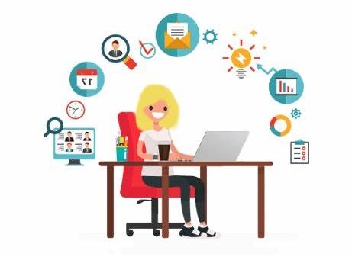
Resource Requirements
Area
Dumping
Time
Employee
Maps

Slide 6
System Model
User Login
Request Pending
Selling to others
Request in progress
Size Reduction and cleaning
Find Area
Request for plastic collection
Collect all plastics by employees
Payment Method

Slide 7

How we will develop the project?
HTML
CSS
JavaScript
Bootstrap
PHP
MySQL

Slide 8
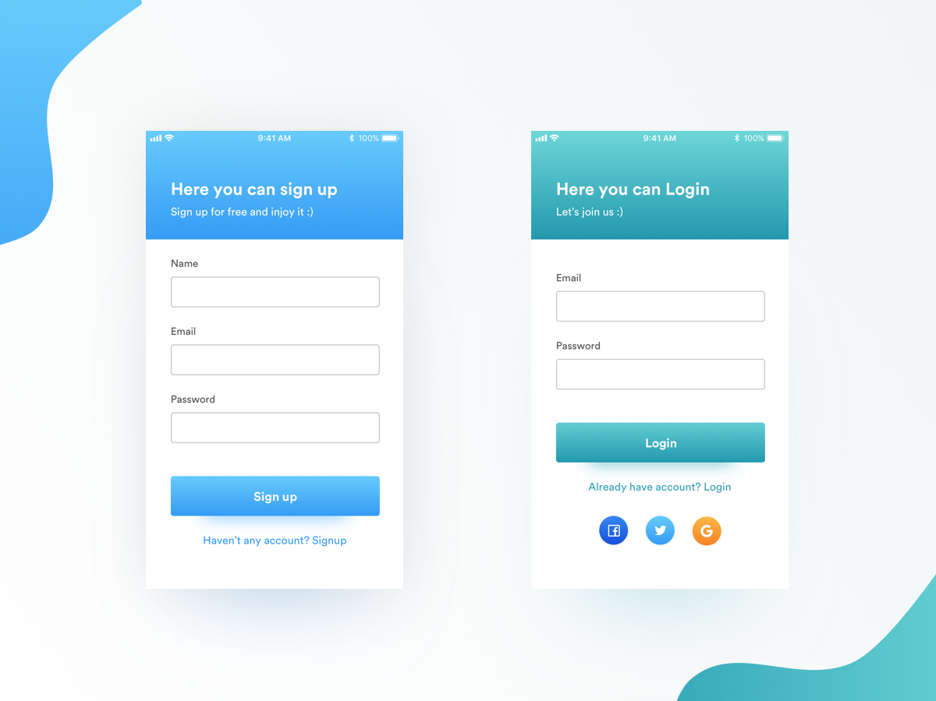
User System Requirements
User Sign Up/Login

Slide 9
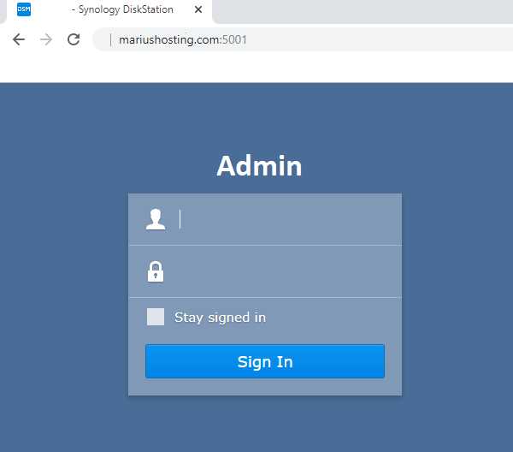

User System Requirements
Admin Login

Slide 10
Account Management
Customer Relationship Management (CRM).
Customer Service
Marketing Strategy
Business Strategy

Slide 11
Saves Energy
Reduces Carbon Emissions
Cheaper than waste collection and disposal
Benefits of our project
Protects Ecosystems
Reduces Pollution Across Ecosystems
Conserves Our Natural Resources
Promotes a Sustainable Lifestyle

Slide 12
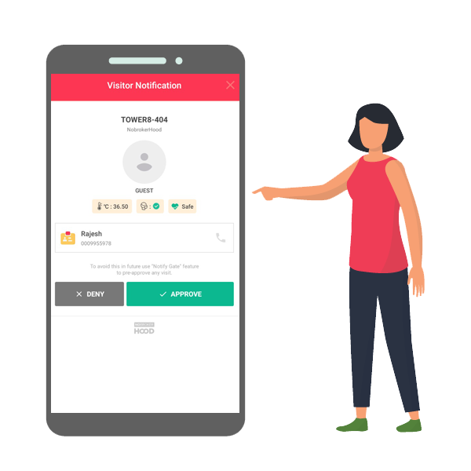



We are facing some problems
How will the user get payment?
Solution

Slide 13
Gantt Chart
Process
Aishorjo
Final Testing
Tanny
Shara
Customization
Coding Part
Design
Planning
Time
Sep 22
Oct 22
Nov 22
Dec 22
Jan 23
Feb 23
Mar 23
Apr 23

Slide 14
Some resources
"Plastic Waste Solutions." Plastic Waste Solutions. N.p., n.d. Web. 11 Dec. 2013. <http://plasticwastesolutions.com/> Huebsch, Russell. "Harmful Effects of Plastic Waste Disposal | EHow." EHow. Demand Media, 30 Oct. 2009. Web. 18 Dec. 2013. <http://www.ehow.com/about_5591699_harmful-effects-plastic-waste-disposal.html> "Plastic." Wikipedia. Wikimedia Foundation, 13 Dec. 2013. Web. 15 Dec. 2013. <http://en.wikipedia.org/wiki/Plastic> "Plastic." Wikipedia. Wikimedia Foundation, 13 Dec. 2013. Web. 15 Dec. 2013. <http://en.wikipedia.org/wiki/Plastic>."Plastic." Wikipedia. Wikimedia Foundation, 13 Dec. 2013. Web. 15 Dec. 2013. <http://en.wikipedia.org/wiki/Plastic> "Reuse Plastic Bottles." So Creative Things Creative DIY Projects 9 Creative Ideas to Reuse Plastic Bottles Comments. N.p., n.d. Web. 18 Dec. 2013. <http://www.socreativethings.com/9-creative-ideas-to-reuse-plastic-bottles/>

Slide 15
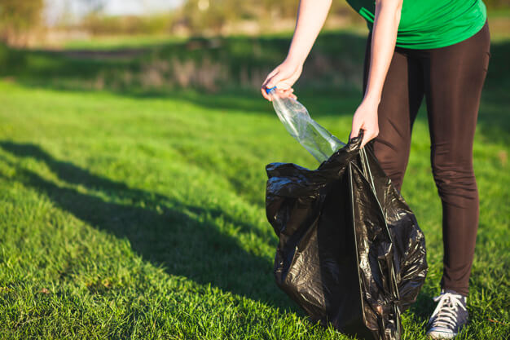
Conclusion
.
Plastics materials in our community is a huge
problem not only for us, but for the animals in
our rivers. To begin, plastic toxins can enter the
human food chain and drastically hurt humans
and the way their bodies work E-Plastic is a
web application which is developed to recycle
products collected from users. This application
retrieves the user’s information returning the
date, day, and time for E-plastic collection.

Slide 16


